Slide 1
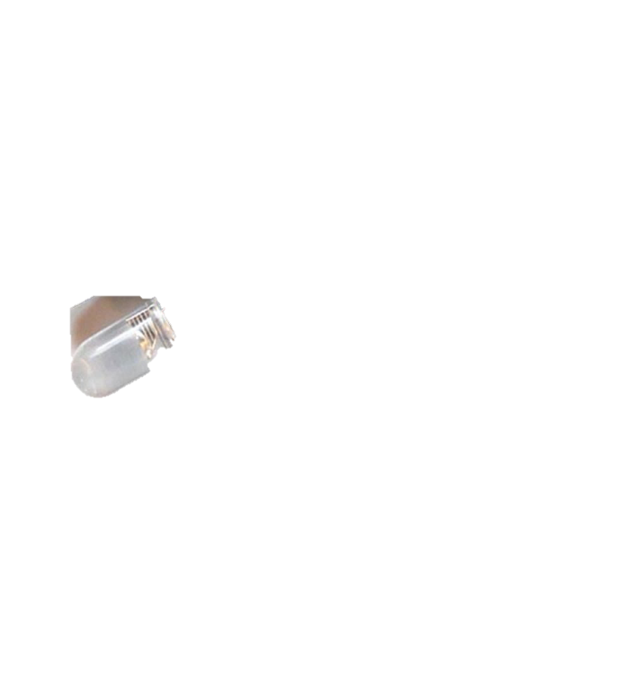
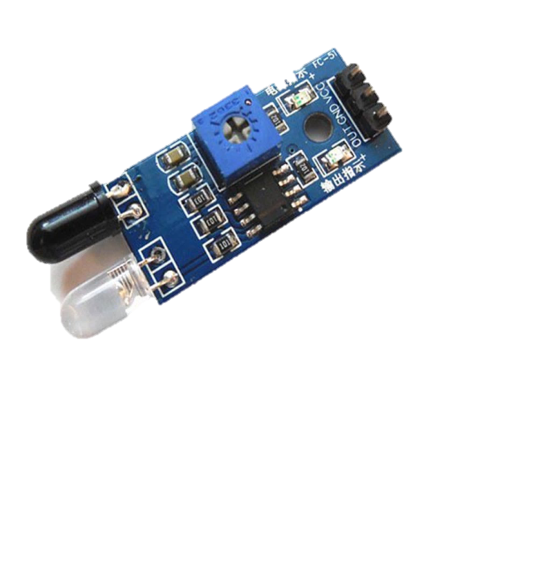
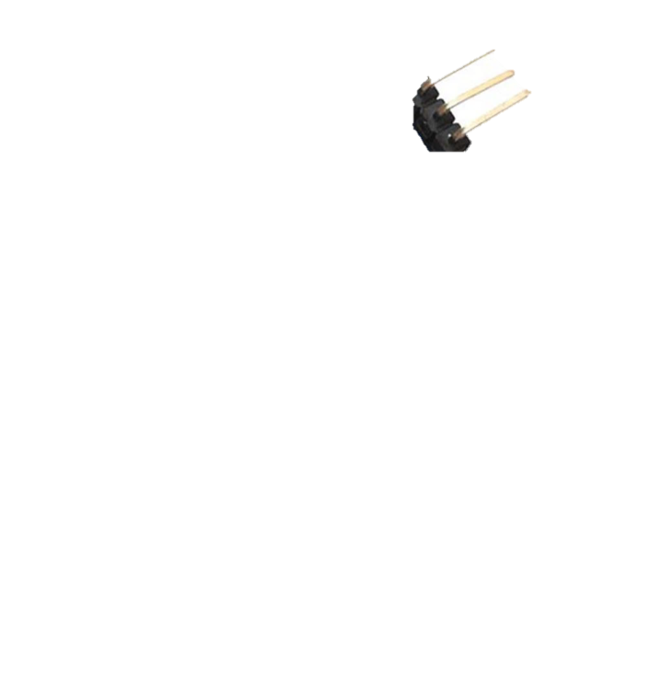
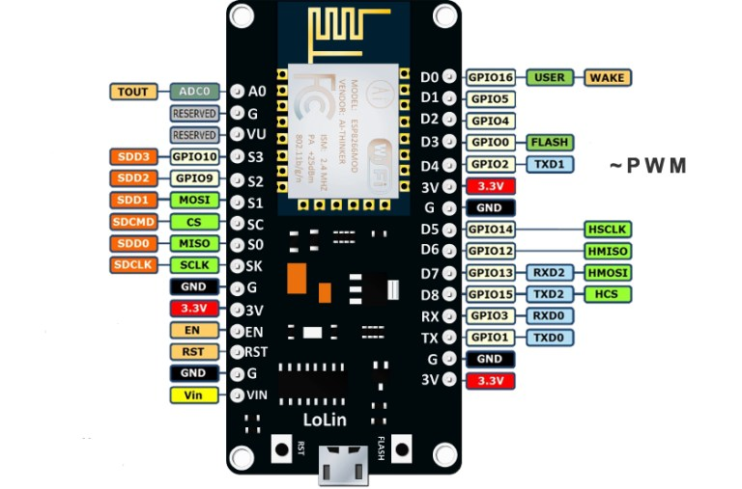
Interfacing ESP8266 with IR sensor

Slide 2
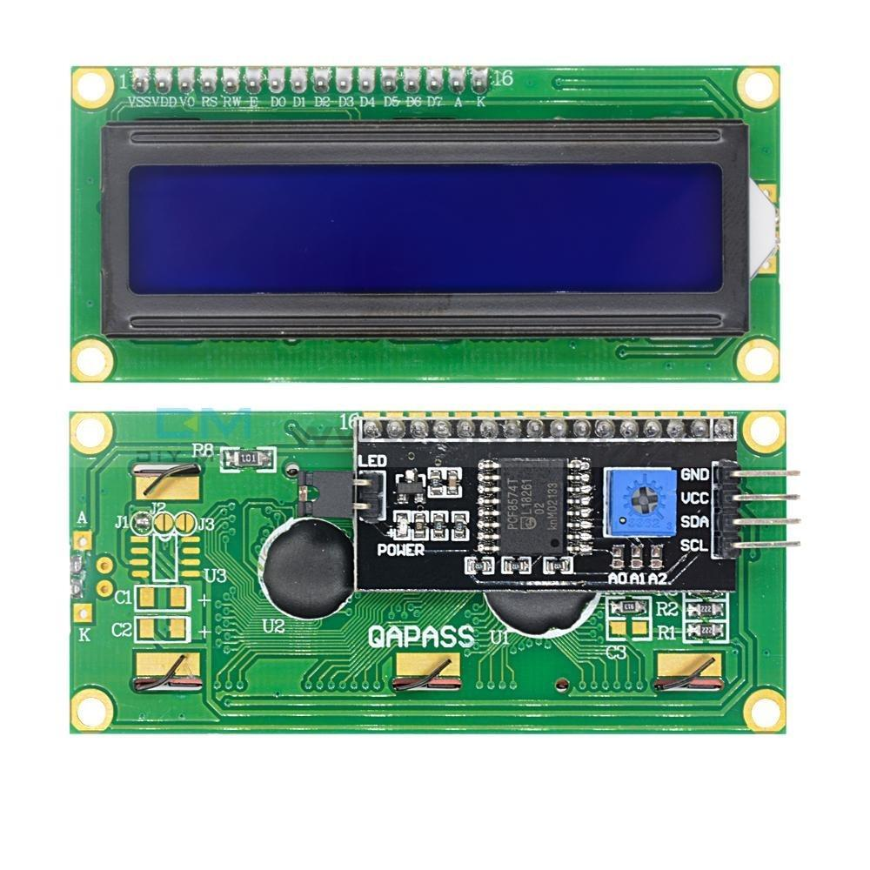
Interfacing LCD and I2C Driver with ESP8266

Slide 3


Interfacing Servo With ESP8266

Slide 4

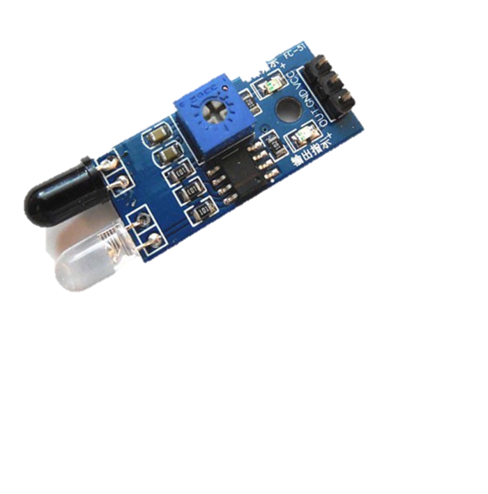



Smart Parking System Using ESP8266

Slide 6
Power Supply
ESP8266
LCD
Servo
IR Sensor
IR Sensor
IR Sensor
IR Sensor

Slide 7
Hardware Requirement:
Micro Controller : ESP8266 Node MCU : 1
IR Sensor : 4
LCD(Liquid Crystal Display) : 1
I2C LCD Driver : 1
Servo Motor : 1
Power Connector : 1
PCB and connecting cables
Software Requirement:
IDE : Arduino IDE
MC Programming Language : C
Additional Library: Servo.h, Wire.h, LiquidCrystal_I2C.h

